Slide 1
2019 TIGR2ESS
2020 openVirus
2021 invasive species
2022 semanticClimate

Slide 2
Gitanjali Yadav, Shweata N Hegde,
Ananya Singha, Axel Duerkop,
Simon Worthington, Priti Chahal,
Peter Murray-Rust
PLEASE ADD OTHERS and affiliations
2019 TIGR2ESS
2020 openVirus
2021 invasive species
2022 semanticClimate

Slide 3
Climate Justice
Making IPCC/AR6 semantic
People and machines re-using Open Access
2019 TIGR2ESS
2020 openVirus
2021 invasive species
2022 semanticClimate

Slide 4
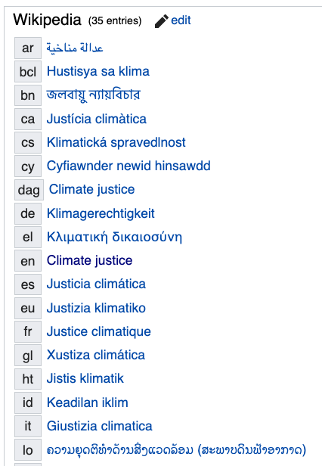
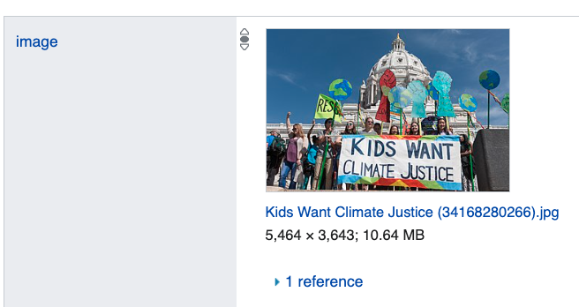

“Climate Justice?”
answers in
Wikipedia and Wikidata
The Scholarly Literature

Slide 5
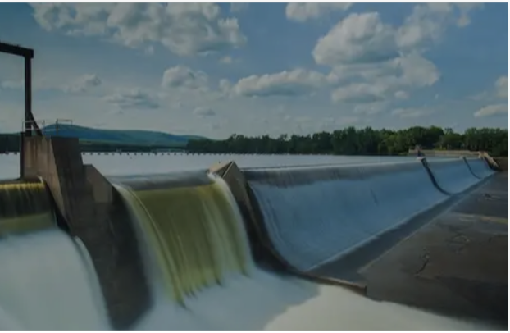
SemanticClimate – what we do
Learning
OA repos
Search
mini-Corpus
Semantic
Literature
Dictionaries
IPCC/AR6
NLP/ML/AI

Slide 6
SemanticClimate – what we do
Learning
OA repos
Search
mini-Corpus
Outcomes
1000 term semantic ClimateChange dictionary
Toolkit for discovery and transformation
Learning community
Semantic
Literature
Dictionaries
IPCC/AR6
NLP/ML/AI

Slide 7

Search EuropePMC for “climate justice”
425 hits
Download 200 (ca 2 mins)
Create wordcloud using NLP and ML
Display in Jupyter Notebook
pygetpapers Ayush Garg
docanalysis Shweata N Hegde
Jupyter/Colab Ananya Singha

Slide 8

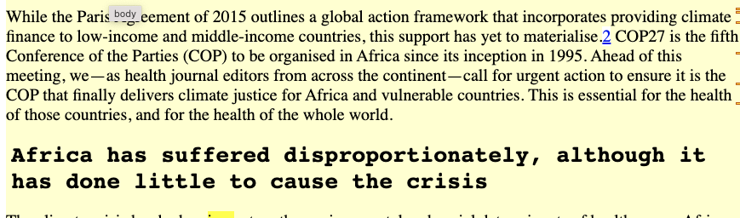
Typical article on “climate justice”
metadata
fulltext

Slide 9
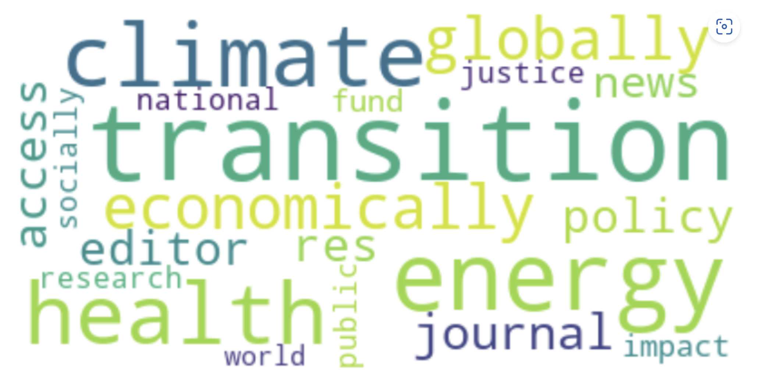
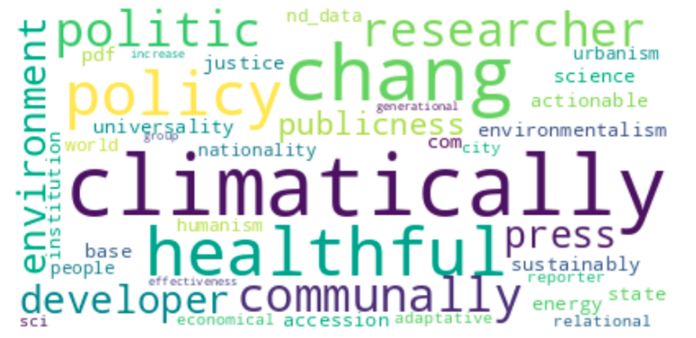
184 Open Access Articles (“climate justice”)
@Ananya Singha code
Lemmatised

Slide 10

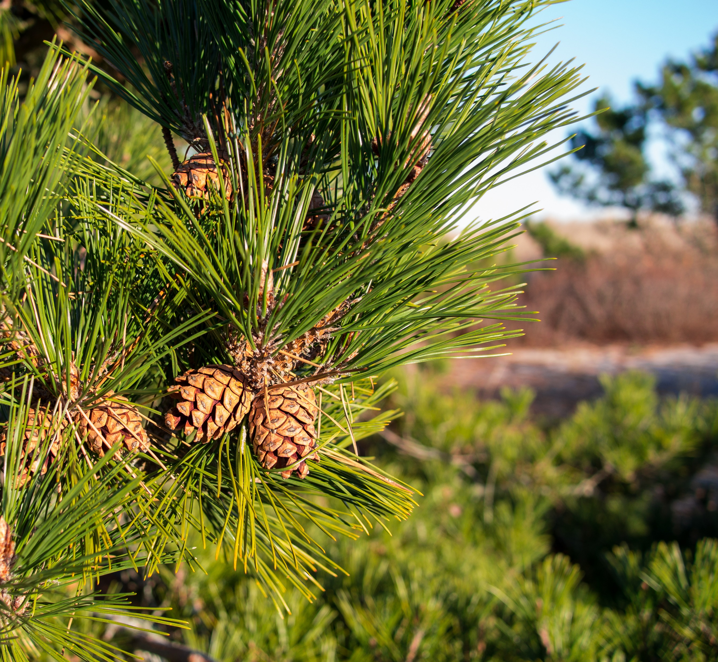
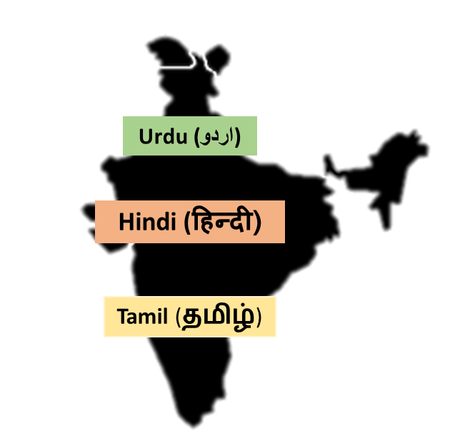


Dictionaries
Cone
<synonym xml:lang="zh">松球</synonym>
<synonym xml:lang="de">Koniferenzapfen</synonym>
<synonym xml:lang="hi">कोणधारी कोण</synonym>
<synonym xml:lang="es">cono</synonym>
<synonym xml:lang="fr">cône</synonym>
Multilingual Plants dictionary
This Photo by Unknown Author is licensed under CC BY-SA
Over 15 dictionaries in use
By Version 1 by Nohat (concept by Paullusmagnus); Wikimedia. - File:Wikipedia-logo.svg as of 14 May 2010T23:16:42, CC BY-SA 3.0, https://en.wikipedia.org/w/index.php?curid=33285413
Slide Credit: Ambreen Hamadani
Notes:
Wikidata and Wikipedia globe
Slide for minicopus
Make it clearer __ explain well
Explain zoonosis
Dictionaries are often called ontology
Critical for annotations and Ontology
Ontology

Slide 11
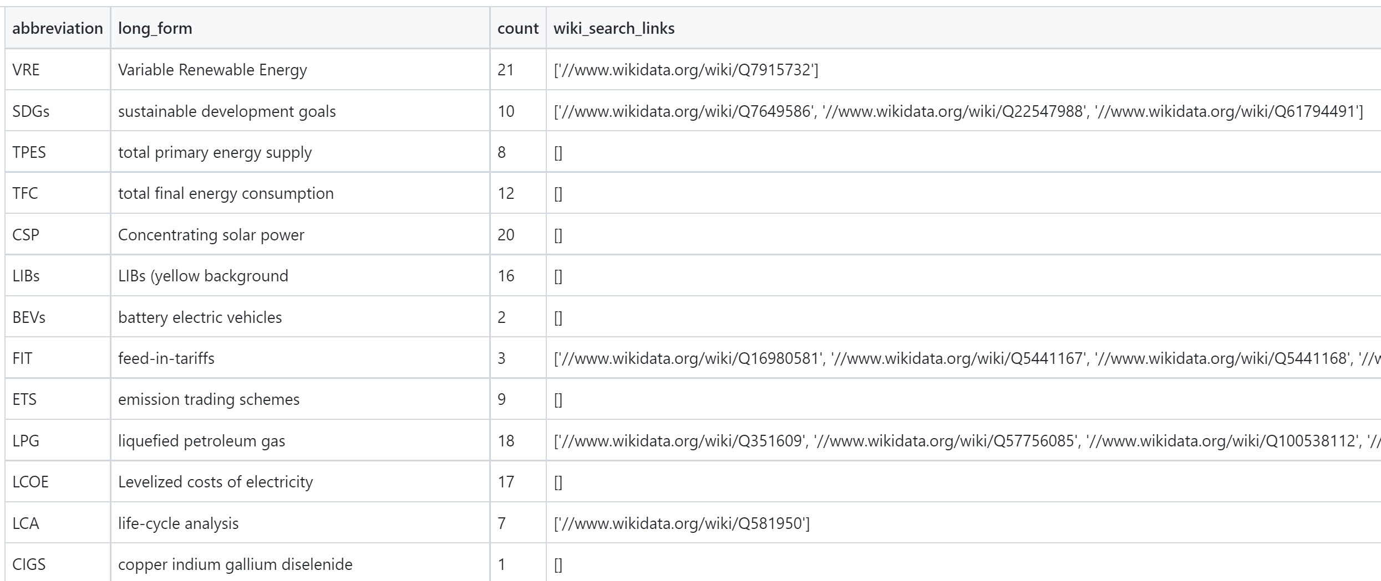
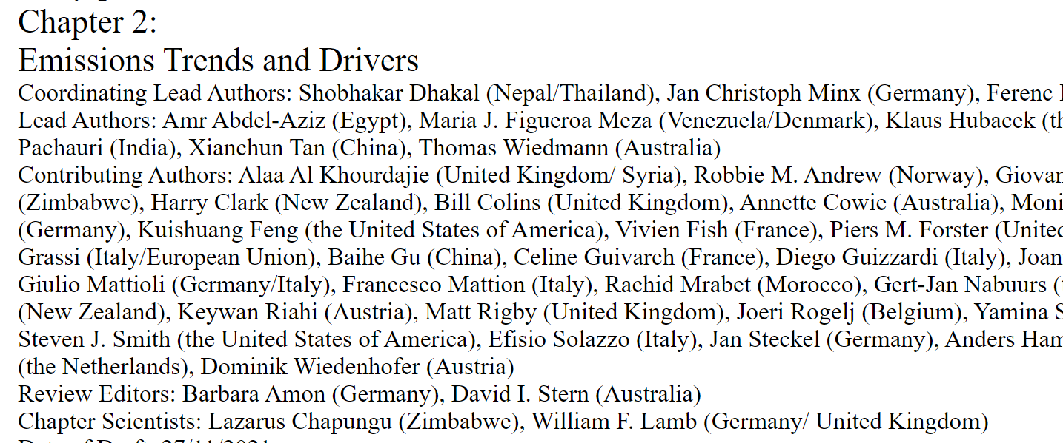
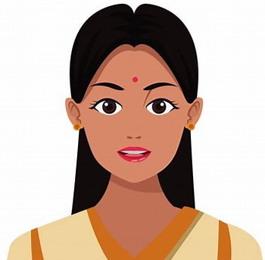
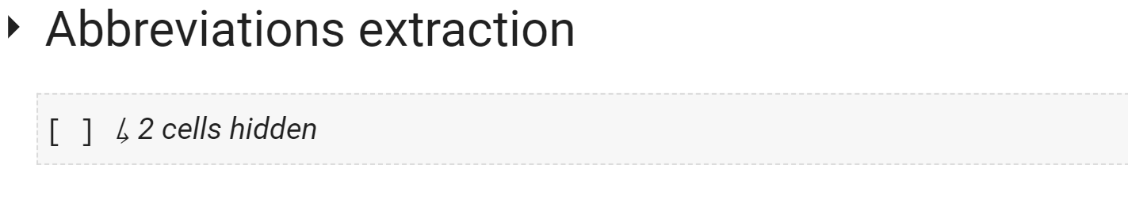

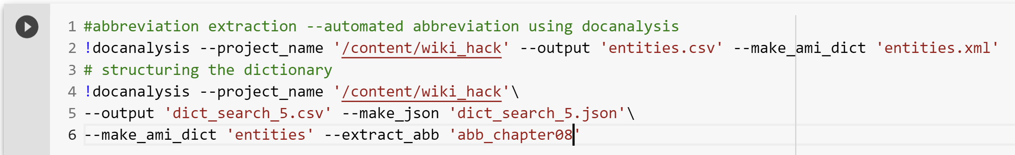
Learning by doing
HTML
Abbreviations
Abbreviation 2
Student Authored
Learning Toolkit
docanalysis
Wow!!!
So easy..
Abbreviation 2
@Ananya Singha

Slide 12
IPCC WG3 17chapters

Slide 13
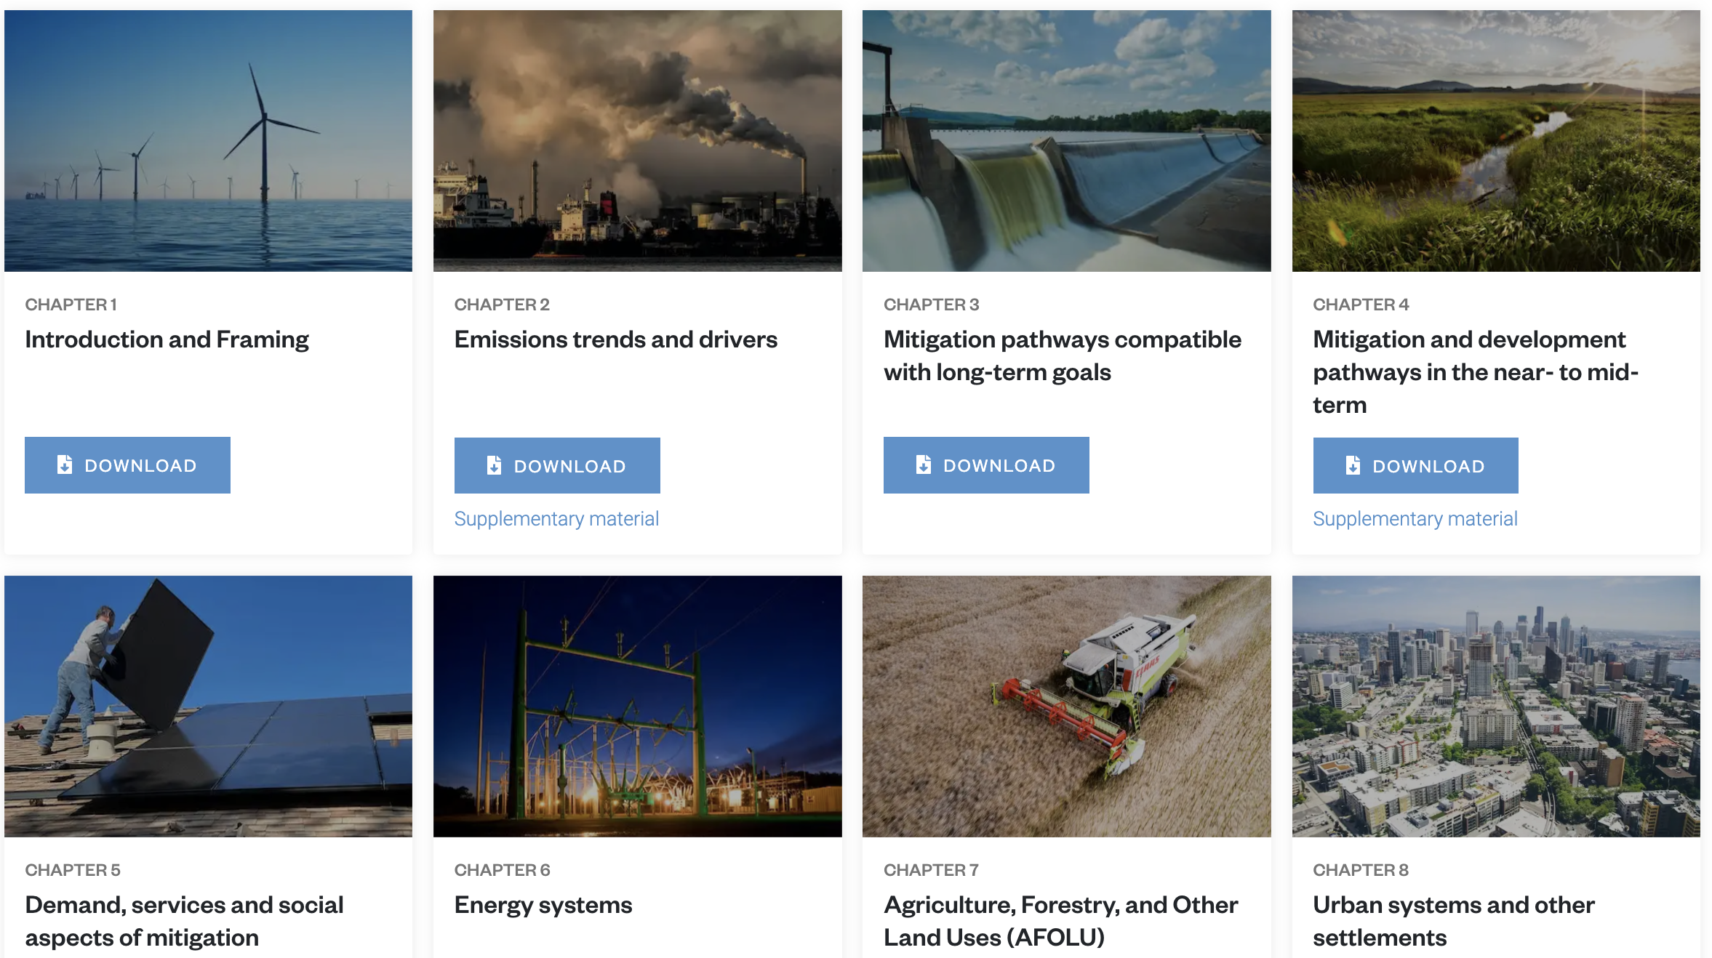
IPCC AR6/WG3 17 Chapters
One chapter per person
semantic dictionary
Hypermedia sections

Slide 14
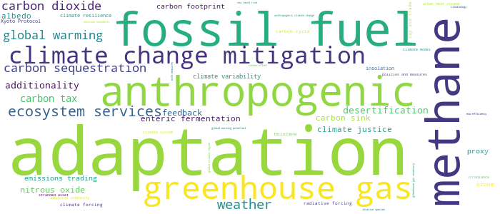
6 Chapters of IPCC WG3
Demo link
{'adaptation': 286, 'fossil fuel': 111, 'methane': 107, 'anthropogenic': 83, 'greenhouse gas': 81, 'climate change mitigation': 66, 'ecosystem services': 48, 'weather': 44, 'carbon sequestration': 35, 'global warming ': 33, 'carbon dioxide': 33, 'carbon tax': 21, 'desertification’: …}
#SemanticClimate’s Climate Knowledge Hunt
docanalysis
Climate justice!
@ShweataNHegde

Slide 15
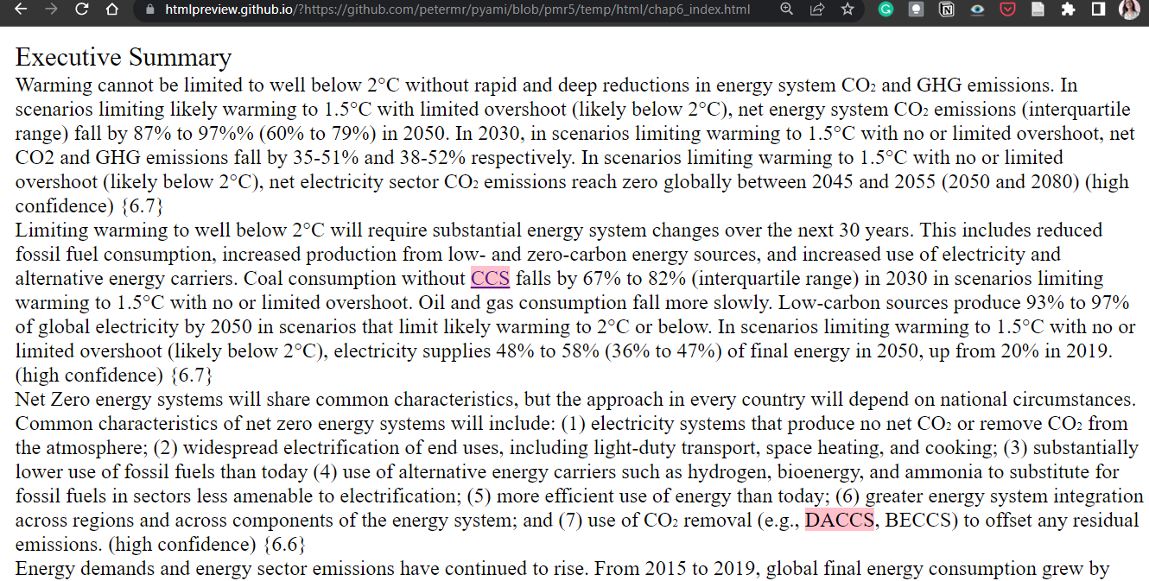
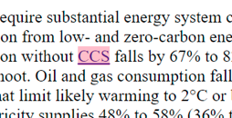
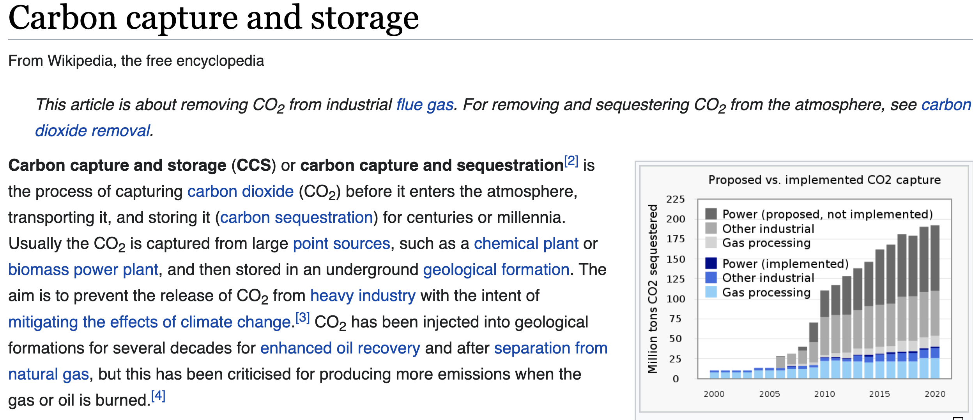
Automatic Indexing with Dictionaries
WG2/Ch2 Exec Summary
Climate Change Dictionary
term="CCS" name=”Carbon capture and storage"
wikidataID="Q41491"
desc="process of capturing and storing waste
carbon dioxide from point sources">
Wikimedia
#SemanticClimate’s Climate Knowledge Hunt

Slide 16
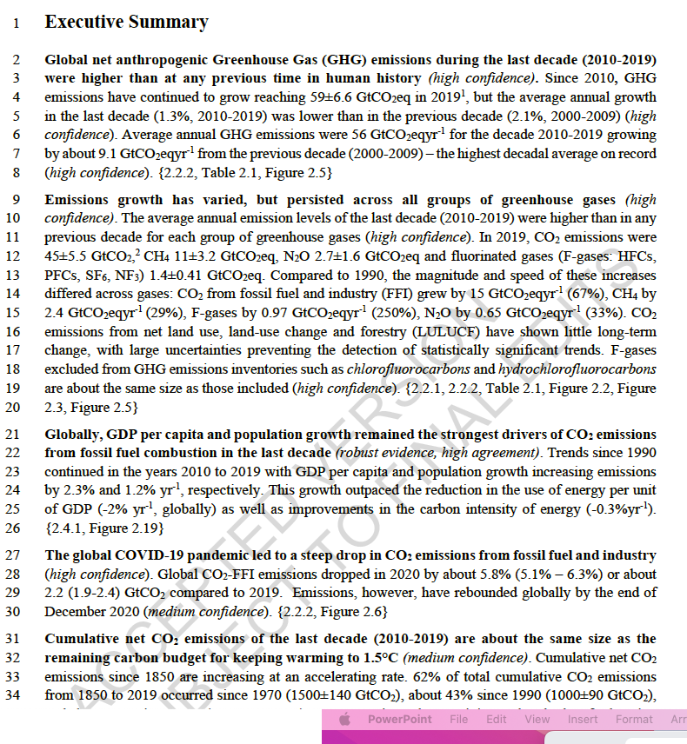
Making IPCC text semantic
Chapter Executive Summary:
25 paragraphs
Implicit references
Create a knowledge graph

Slide 17
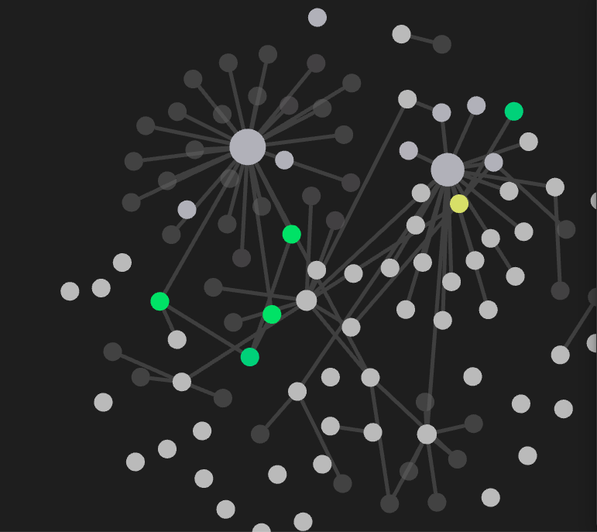
Making IPCC text semantic
2_exec_1
2_exec_2
Paragraphs
2_exec_3
Links to other
chapters
2_exec_4

Slide 18
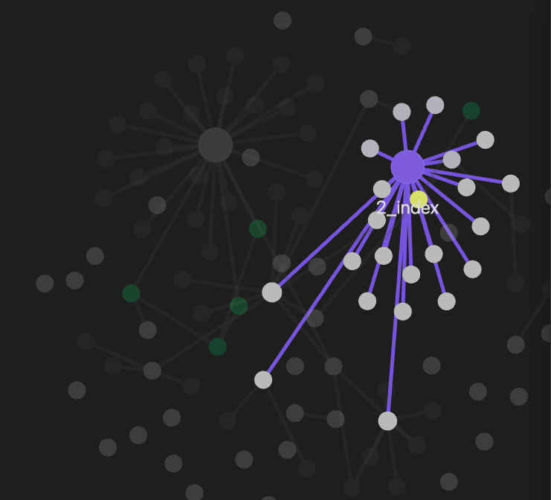
Labeling paras
2_exec_1
Exec_summary_toc
2_exec_2
2_exec_3
paragraphs
2_exec_4

Slide 19
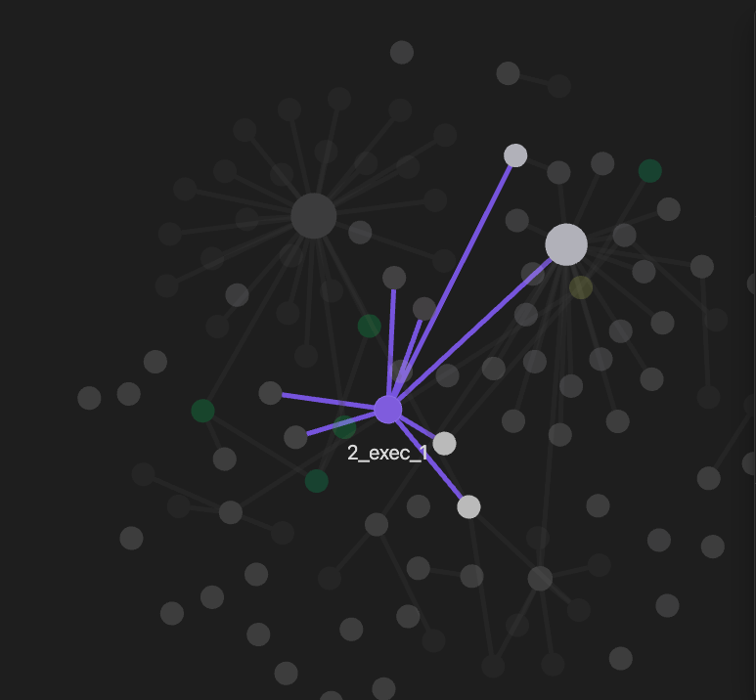
Making IPCC text semantic
2_exec_1

Slide 20
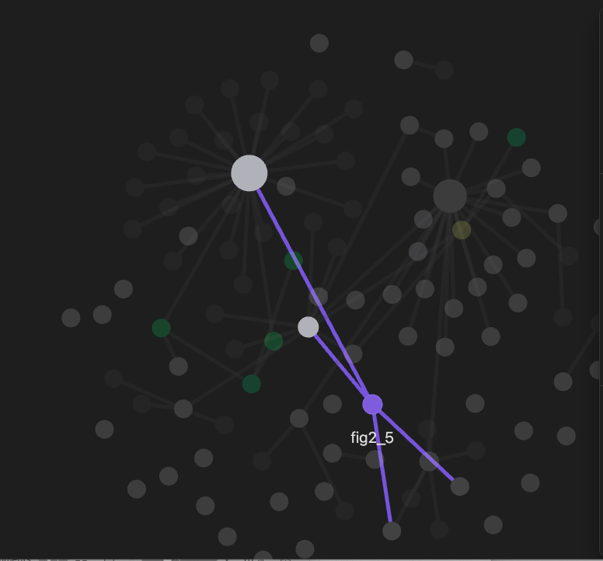
Linking Figures
Figure2.5
Figures

Slide 21
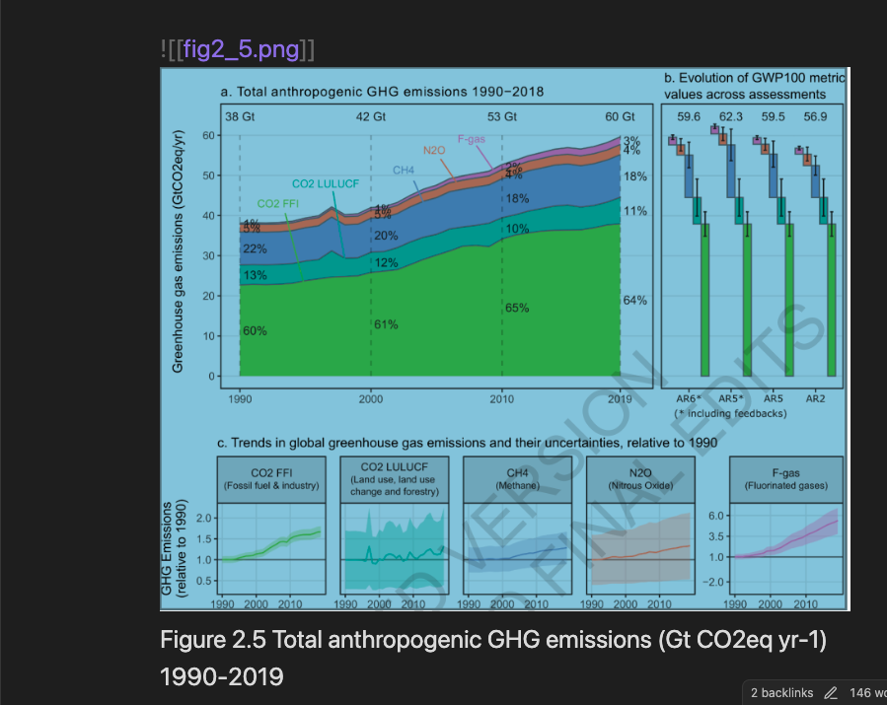
Making IPCC text semantic
Linking Figures
Figure2_5

Slide 22
Last slide
Links to software, pages etc.
Thanks

Slide 23
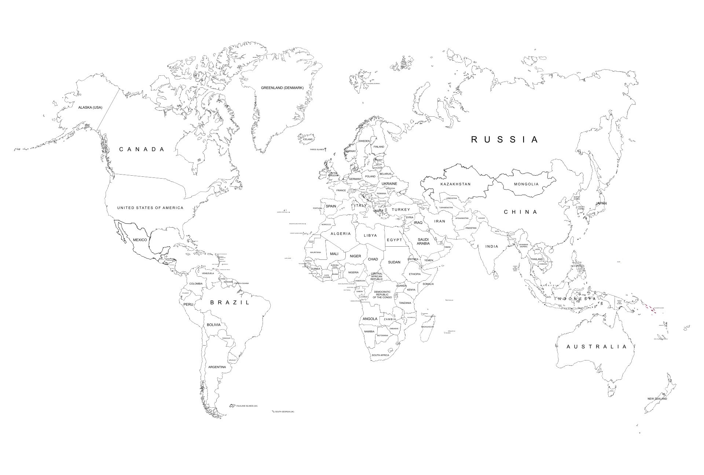

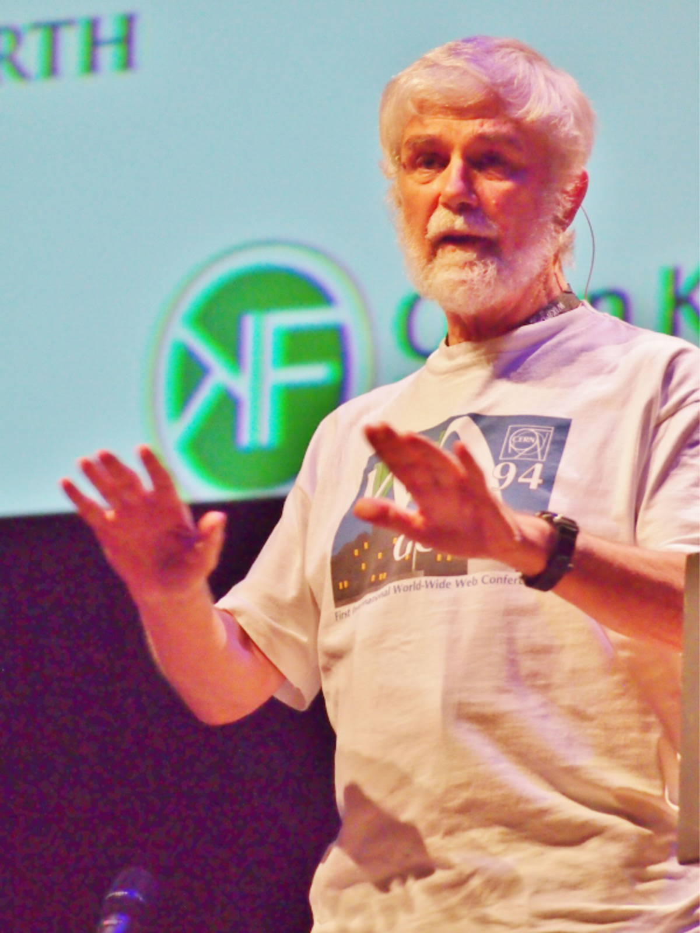



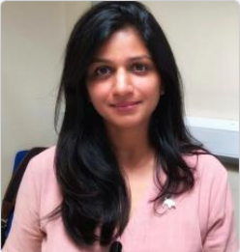
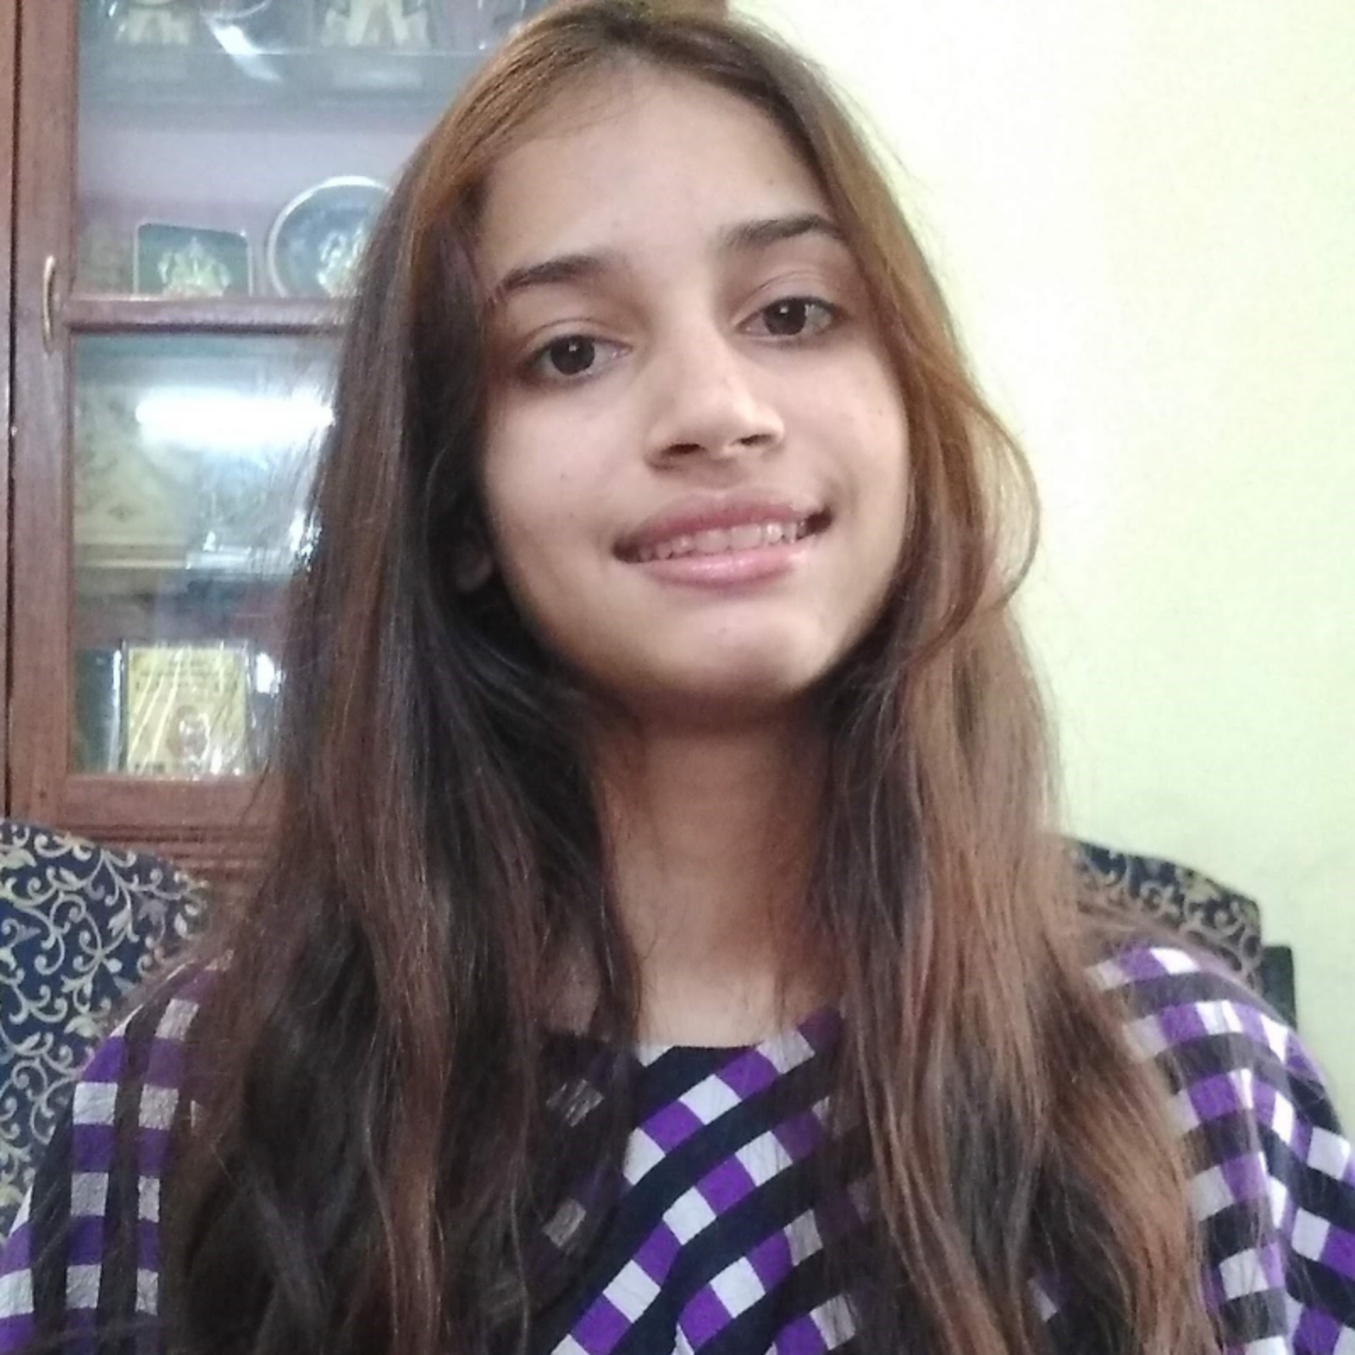
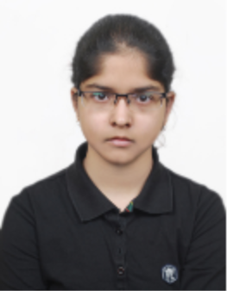

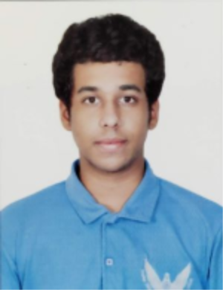

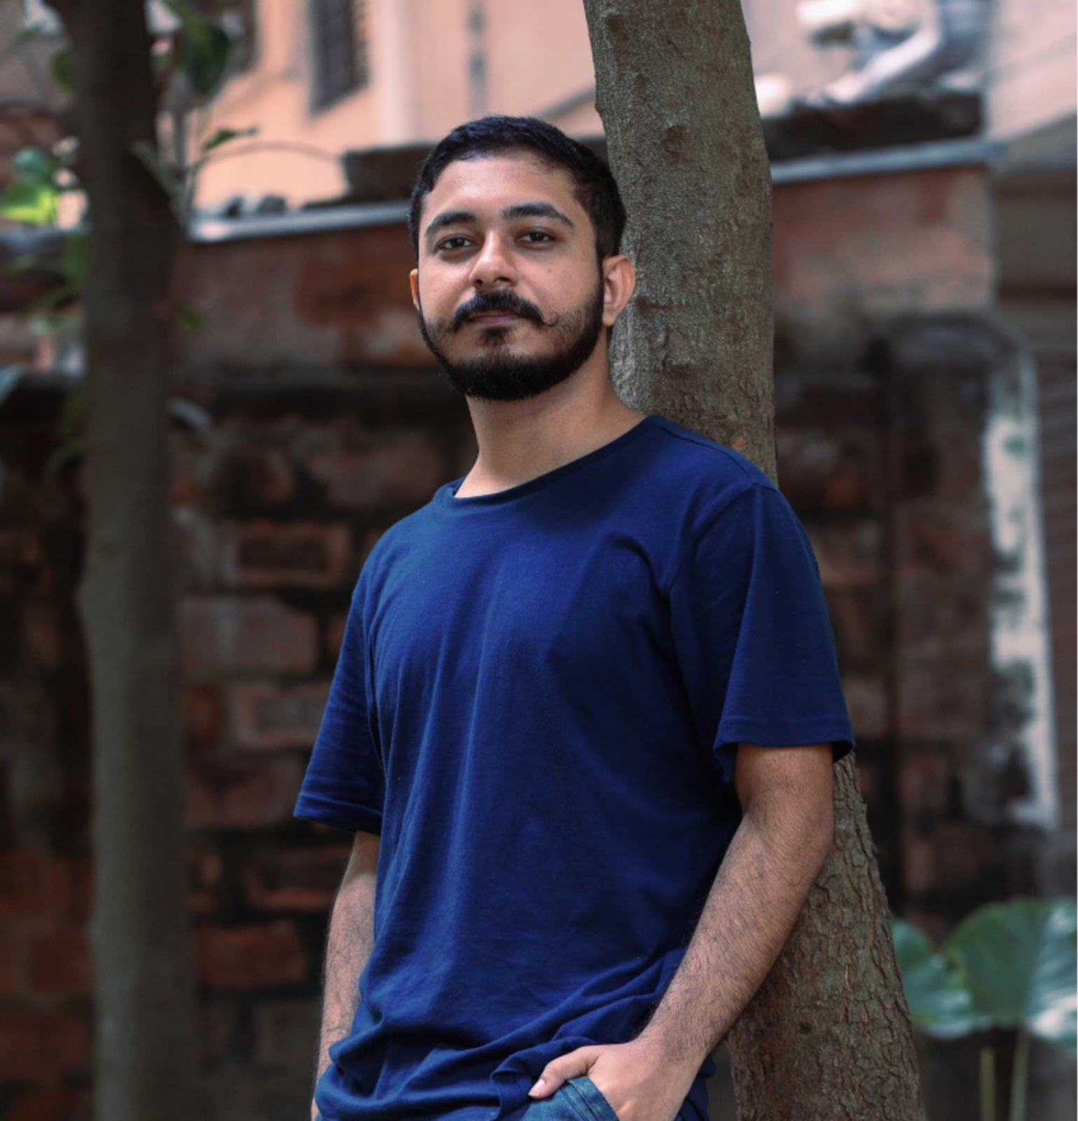
Semantic Climate -- 2022
Simon
Add more people
Slide credit: Enakshi Das

Slide 24
Plant Parts Dictionary (CEVOpen)
<entry term="cone“ wikidataURL="http://www.wikidata.org/entity/Q22710" wikidataID="Q22710" wikipediaPage="https://en.wikipedia.org/wiki/Conifer_cone">
<synonym>Cone, Conifer cones, Strobilus, pine cone, pine-cone, pinecone, pine cones</synonym>
<synonym xml:lang="zh">松球</synonym>
<synonym xml:lang="de">Koniferenzapfen</synonym>
<synonym xml:lang="hi">कोणधारी कोण</synonym>
<synonym xml:lang="es">cono</synonym>
<synonym xml:lang="fr">cône</synonym>
<description xml:lang="fr">organe reproducteur des conifères</description>
<description xml:lang="es">estructura vegetal</description>
</entry>
term
Multilingual entries
Credits: Vasant Kumar

